Slide 1
Capstone Project
Health Insurance - Cross Sell Prediction
By Tapomay Sahoo and Shivam Tiwari

Slide 2
Points for discussion
Know the project
EDA
Feature Engineering & Data pre-processing
Model Building
Conclusion

Slide 3
Know The Project

Slide 4
Problem Statement
Our client is an insurance company who wish to sell their health insurance customers vehicle insurance. And they have provided us with the dataset from their first attempt.
We are supposed to find insights from their first attempts and then build a predictive model to predict which customers in future are more likely to buy their vehicle insurance.

Slide 5
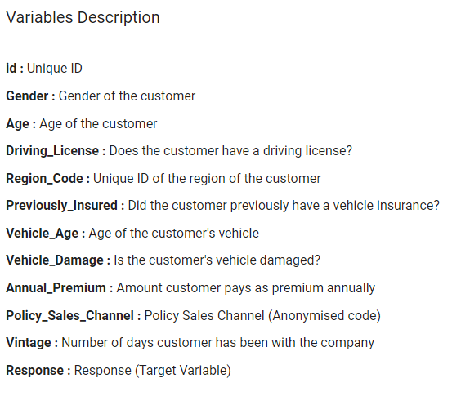
Data summary
From the first looks, the dataset looks a lot cleaner than most ones we usually work with. It has no null values and no duplicate values.
We have 381109 data points, 11 independent variables and one dependent variable, Response.
Most of the variables are categorical in nature. Only three are truly numeric in nature.

Slide 6
EDA

Slide 7
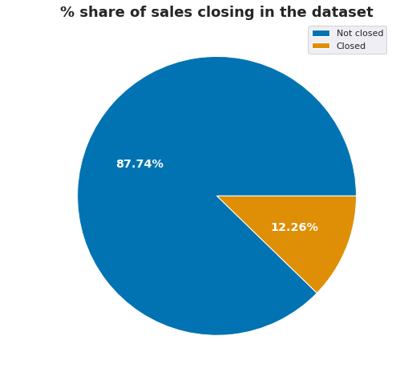
What is the distribution of customer final response in our dataset?
Getting the sales done is not easy regardless of how much information one can get of the customer.
And so, the distribution of sales closed and not closed would be very skewed in nature.
Only 12.26% of the sales were closed by the team.

Slide 8
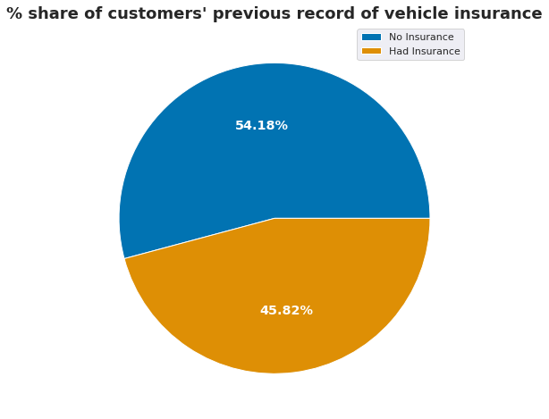
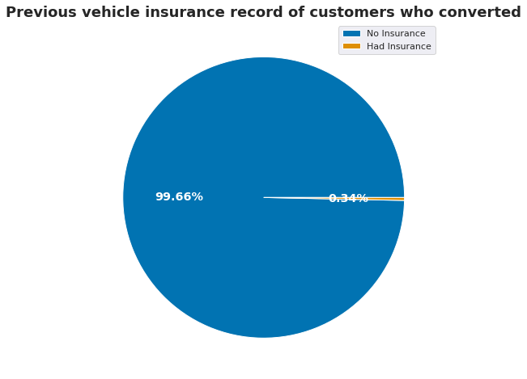
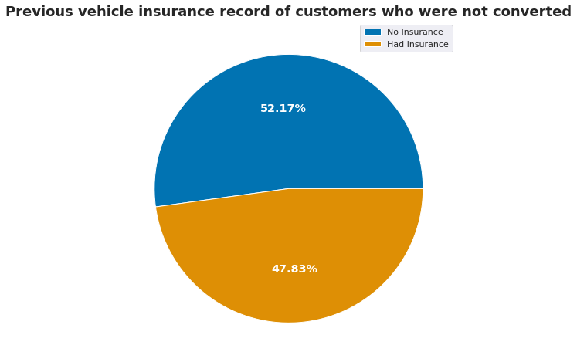
What is the distribution of customers’ previous record of having a vehicle insurance?
From the data that we have of our health insurance customers, we understand that 54.18% of them do not have any record of vehicle insurance in the previous years. This certainly is a big market to try and penetrate and so campaigns that helps a user understand the benefits of having a vehicle insurance must be created.
And for those who have had vehicle insurances, it should be studied what was for them an ideal vehicle insurance. Understanding what a customer needs is as important as making awareness campaigns of your services.
Almost all the customers (99.66%) who converted, converted from the ones who never really had a vehicle insurance before.
Given how our main customer base is the one who never had a vehicle insurance, 52.17% not accepting our initial offers makes the market with still a lot more opportunities.

Slide 9
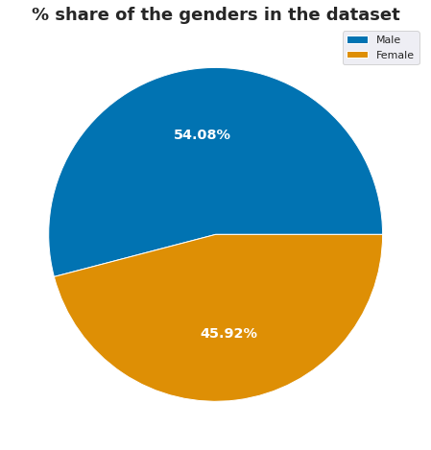
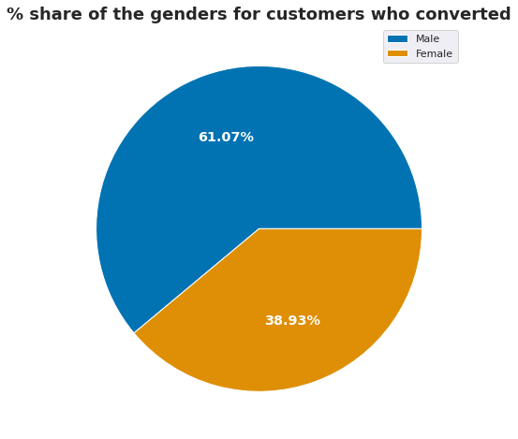
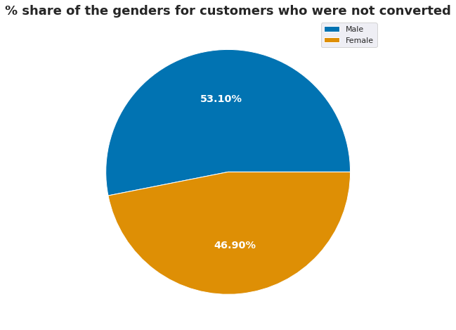
What is the gender distribution of our customers and of those who converted?
Our health insurance customers' dataset has 54.08% males and 45.92% females.
We have not been as popular amongst our female health insurance customers when it comes to swaying them into buying our vehicle insurances as well as we would have liked to. Only 38.93% females have converted and 61.07% males have converted of the ones who converted.
Of the ones who did not convert to buy our vehicle insurances, the numbers are somewhat more consistent with what they are for the overall dataset. 53.1% males and 46.9% females didn't convert.

Slide 10
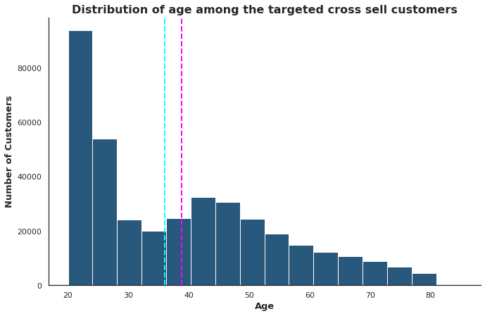
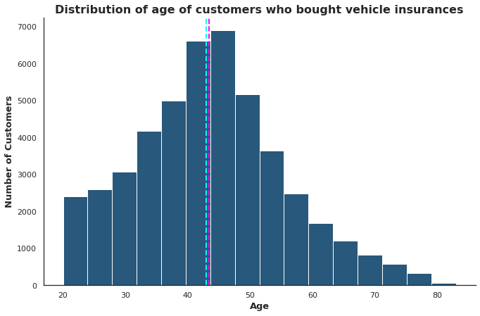
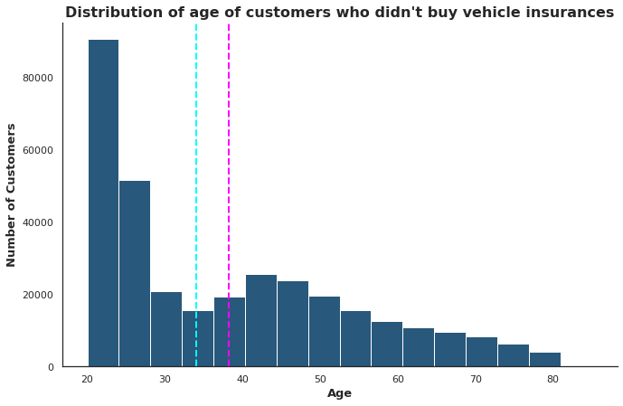
What is the distribution of the age of the customers?
The distribution of the age of the customers is positively skewed. Its mean is somewhat close to 38.82 whereas the median is 36.
The distribution of age for the customers who responded positively is a more like Gaussian distribution with mean and median both almost equal. Mean is 43.43 whereas median is 43.
The middle-aged customers showed more interest in our vehicle insurance.
Since the negative responses are high in number, the distribution of age in the negative responses resemble the distribution of age in the overall dataset.
The mean here is 38.17 and the median is 34.

Slide 11
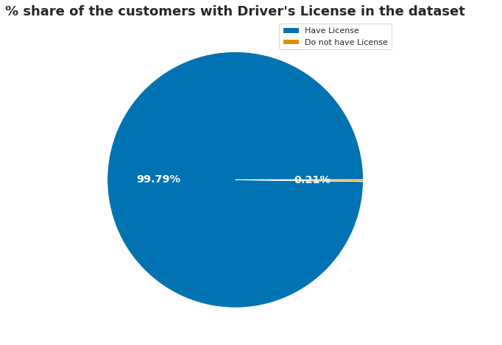
What is the distribution of customers with a driving license?
Almost everyone targeted holds a vehicle insurance, as expected. Only 0.21% of the customers targeted don't have a driving license.

Slide 12
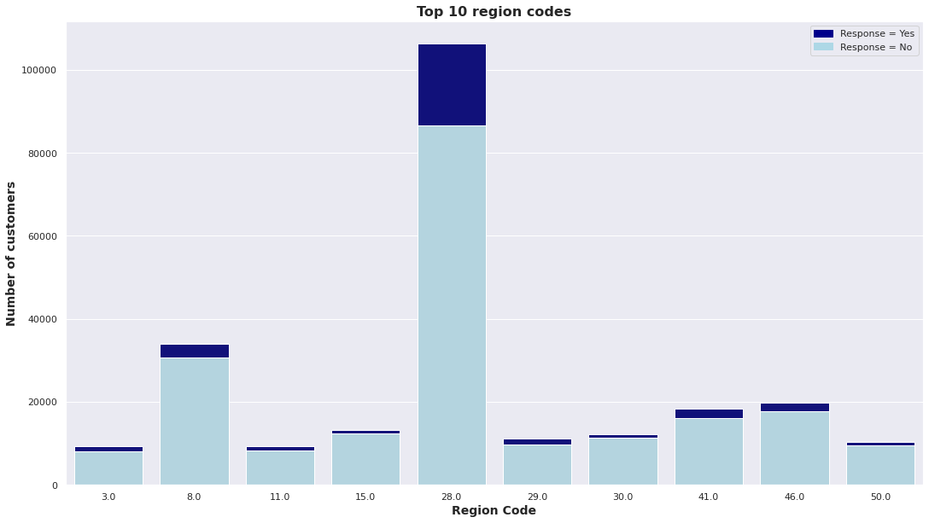
Which are the top 10 region codes and what are their performances?
Region with code 28 has the most customers and perhaps the highest percentage of success in terms of cross selling. Overall a very small percentage of customers from the regions with most population buy our vehicle insurances.
It should be studied how we achieved huge success in Region 28 and perhaps implemented what worked there in the other regions.

Slide 13
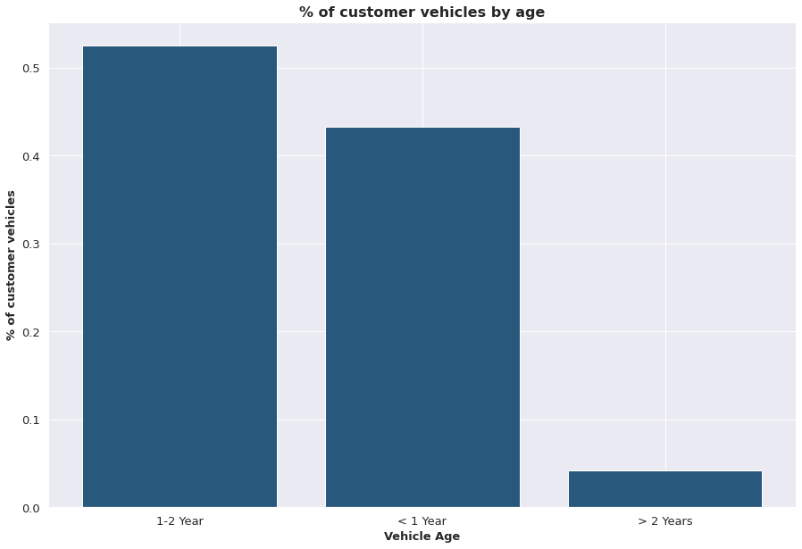
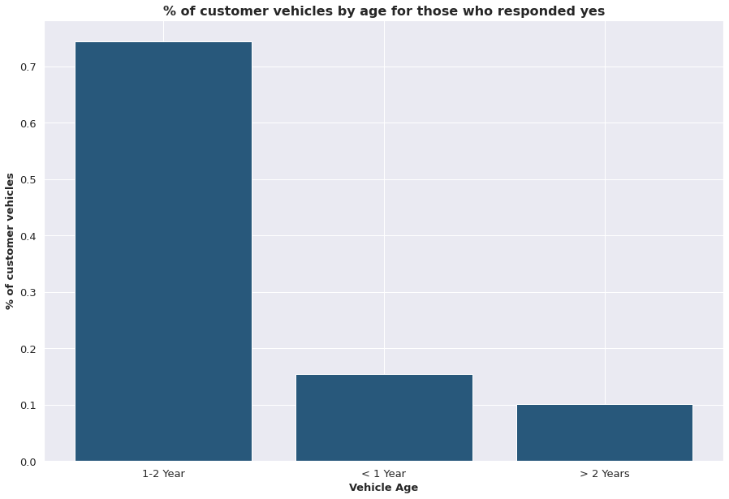
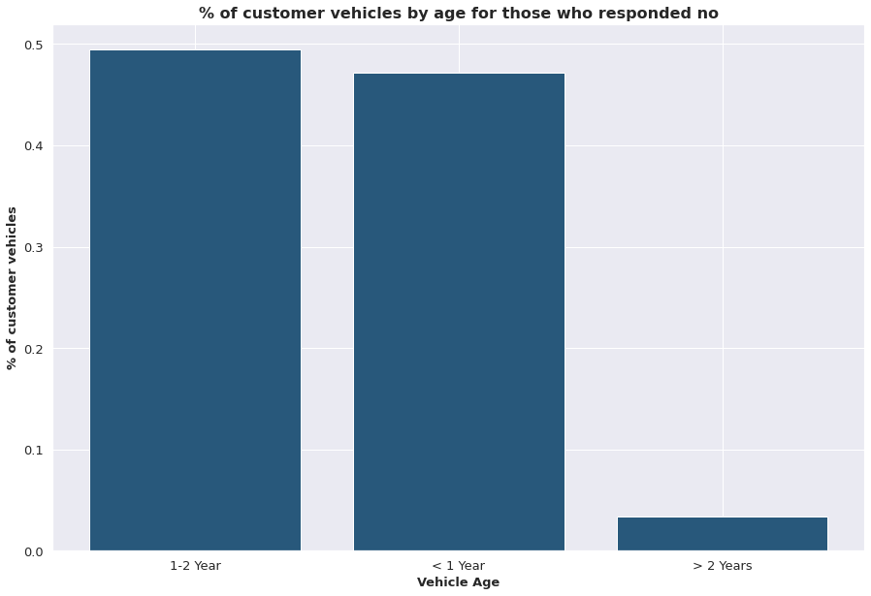
What is the distribution of vehicle age of the customers?
There are not many vehicles very old, with only 4% older than 2 years. And more than half of the customers (53%) have vehicles between the age of 1 and 2 years. Rest 43% have vehicles lesser than a year old.
Customers with vehicles of age between 1 and 2 years have showed the most interest in our insurance. 3/4th of the customers who responded yes belong to this category.
The share of the customers who responded no grows for those who have vehicles of age less than a year. It is perhaps they already have an existing vehicle insurance.

Slide 14
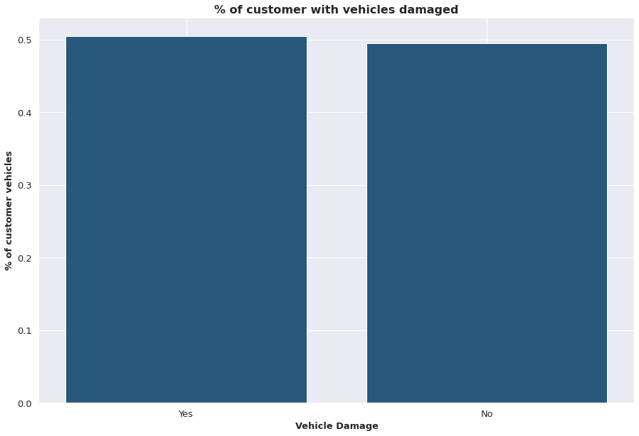
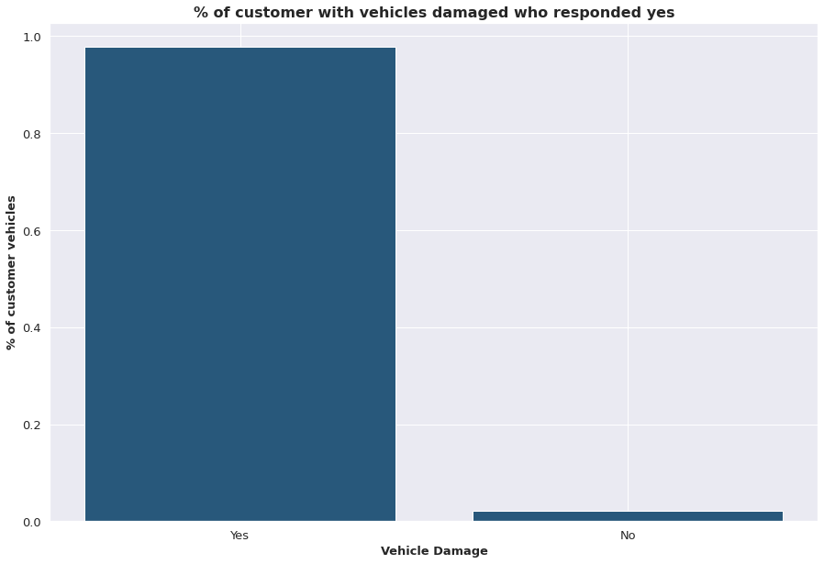
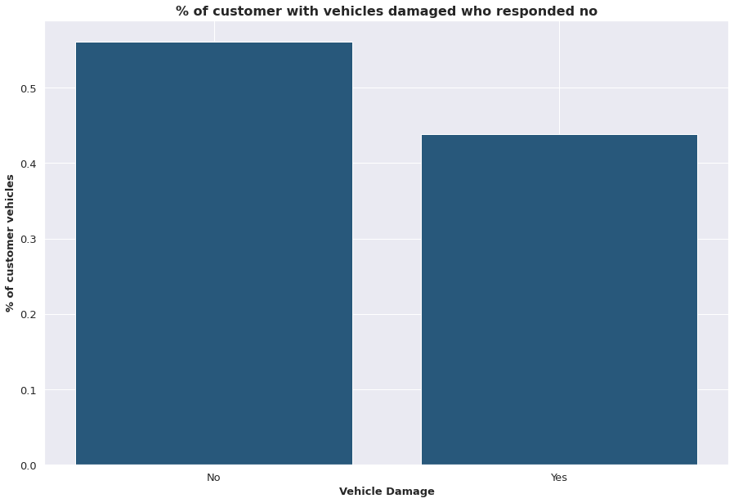
What is the distribution of vehicle damages in the dataset?
The distribution of customers with damaged vehicles and customers without is almost equal.
Almost all of the customers who responded yes to buying our vehicle insurance have damaged vehicle. Only 2% don't.
56% of customers who responded no didn't have damaged vehicles.

Slide 15
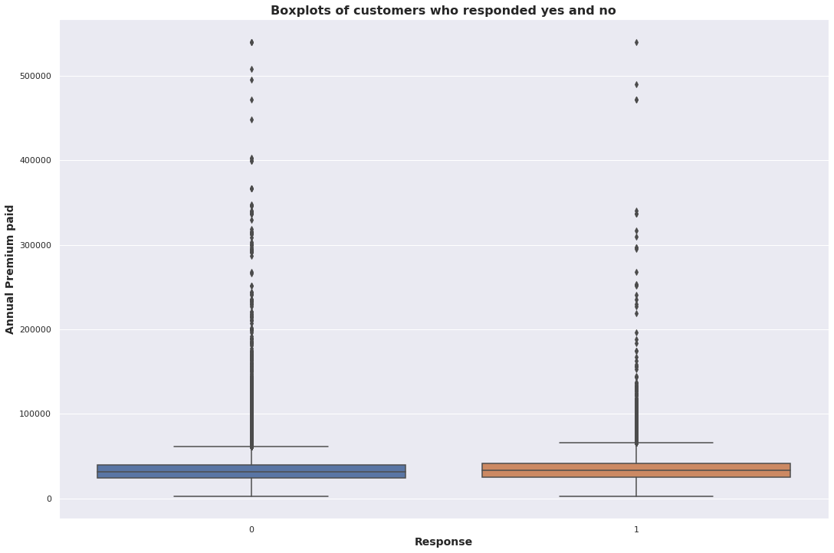
What is the distribution of the annual premiums?
The two types of customers (ones who responded yes and ones who responded no) seem to have similar distribution of their Annual Premium.
The distribution is slightly higher for those who responded yes, but the difference is too little to seem significant for the 40-50 percentiles of the customers.

Slide 16
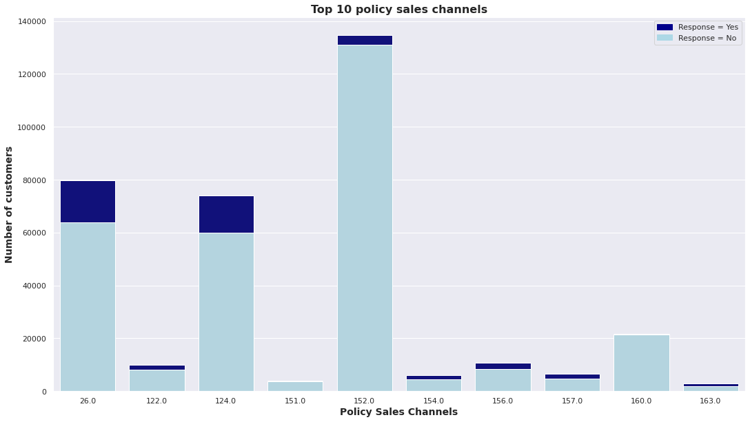
Which are the top 10 policy sales channels and how do they perform?
Policy Sales Channels 26.0 and 124.0 are working way better than the others whereas the policy sales channels 152 and 160 are resources wasted with very limited or no return at all.
It is advisable to focus the resources more on channels that do well.

Slide 17
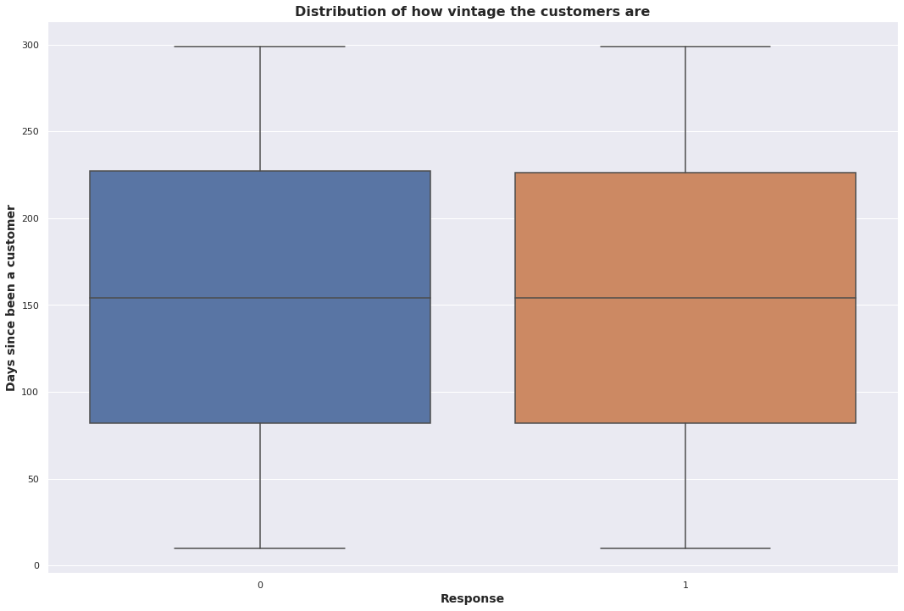
What is the distribution of customers’ vintage?
The distribution of the customer's age with the company is same for both the types - ones who bought the vehicle insurance and ones who didn't.

Slide 18
Feature Engineering & Data Pre-Processing

Slide 19
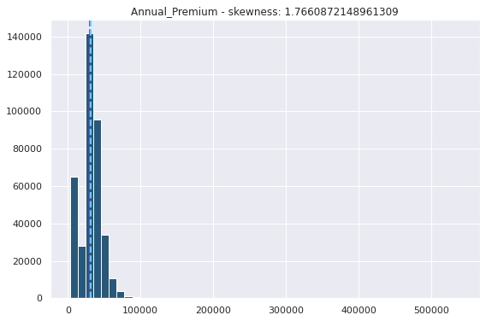
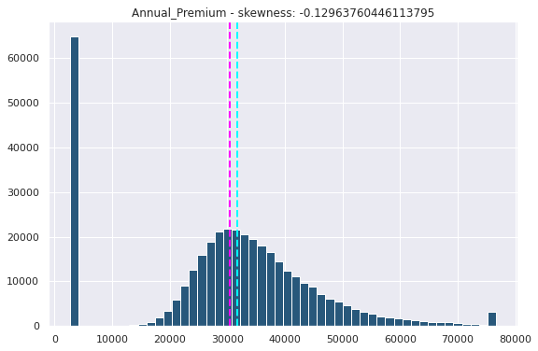
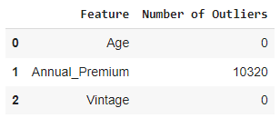
Dealing with Outliers and Null Values
We found no missing values in the dataset.
And only Annual_Premium column contains outliers. And so, after looking at its distribution, we decided to fix it using the IQR method, given the skewness of the distribution.

Slide 20
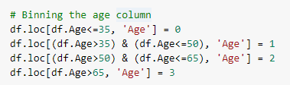
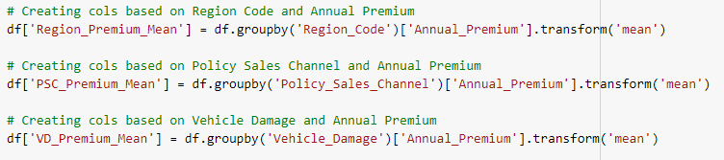
Feature Manipulation
We have created several new features using multiple possible combinations of the existing numerical and categorical features in the dataset. These new features were created using the transform method on groupby data and by binning the age column.

Slide 21
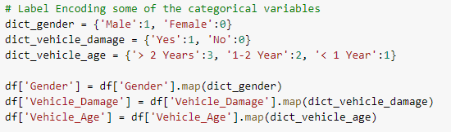

Categorical Encoding
We dummy encoded (one-hot encoded) the Region Code and Policy Sales Channels as they were codes that did not have any numerical meaning and we label encoded the Gender, Vehicle Age and Vehicle Damage columns.
But before dummy encoding the Region Code and Policy Sales Channels columns, we decided to group all the options with lesser than 3% of presence in the dataset.

Slide 22



Feature Selection and Data Splitting
We have dropped columns like Id and Driving_License. These have values that we believe won't help.
One important point of note here is that we have skipped over the process of eliminating the multicollinearity in the dataset. That is, because, the classification problem, the dataset and the kind of variables on hand point completely towards the use of tree based and ensemble based methods.
We decided to split the dataset between the train and test sets in the ratio 75:25.

Slide 23

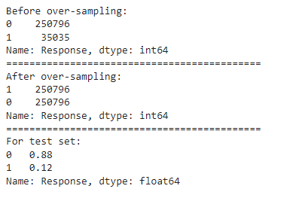
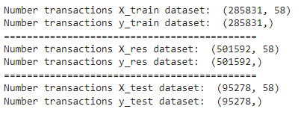
Handling Imbalanced Data
We have used the Random Oversampler from the sklearn library to over sample the positive responses given how they were occupying only 12% of the dataset before the sampling.
A more evenly distributed response helps us predict both the kinds of responses with ease.

Slide 24
Model Building

Slide 25
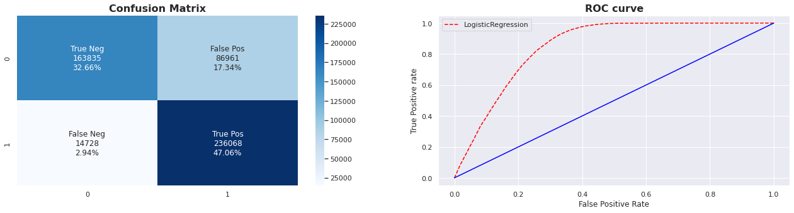
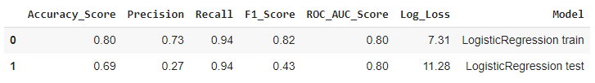
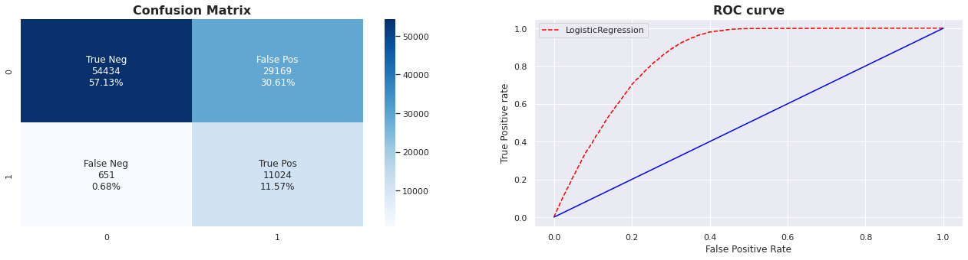
Logistic Regression Model with Hyperparameter Tuning

Slide 26
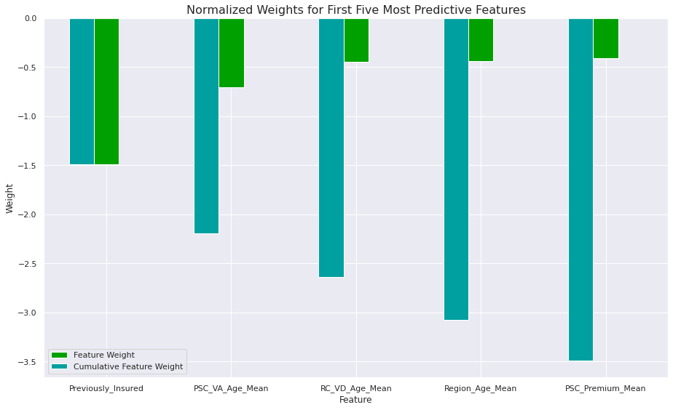
Logistic Regression Feature Importance

Slide 27


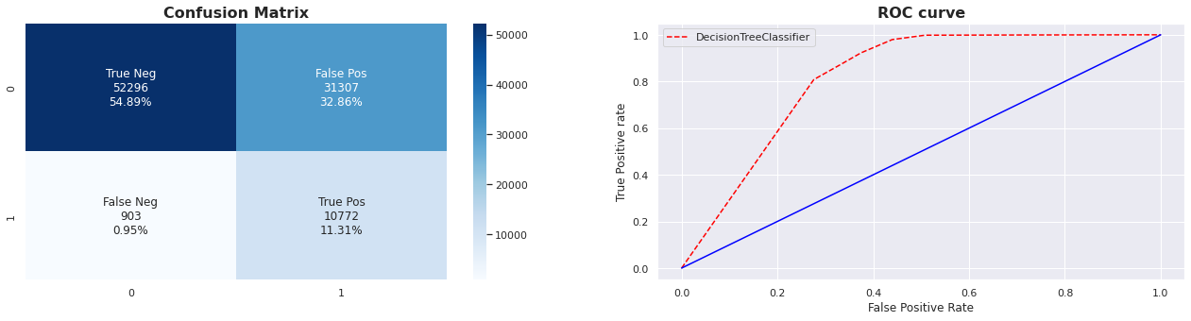
Decision Tree Model with Hyperparameter Tuning

Slide 28
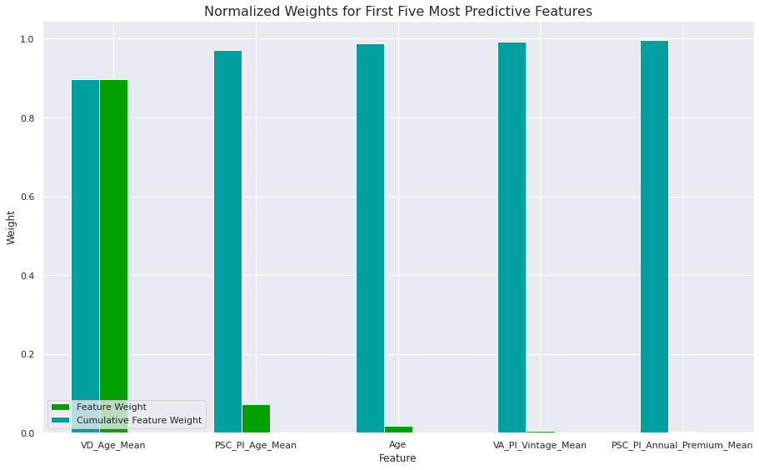
Decision Tree Feature Importance

Slide 29


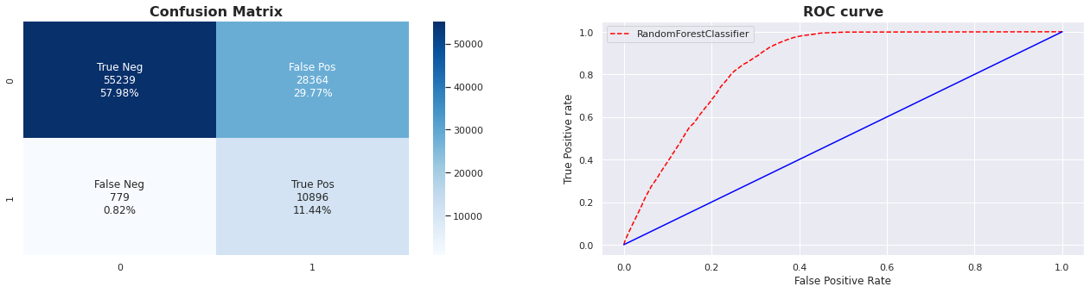
Random Forest Model with Hyperparameter Tuning

Slide 30
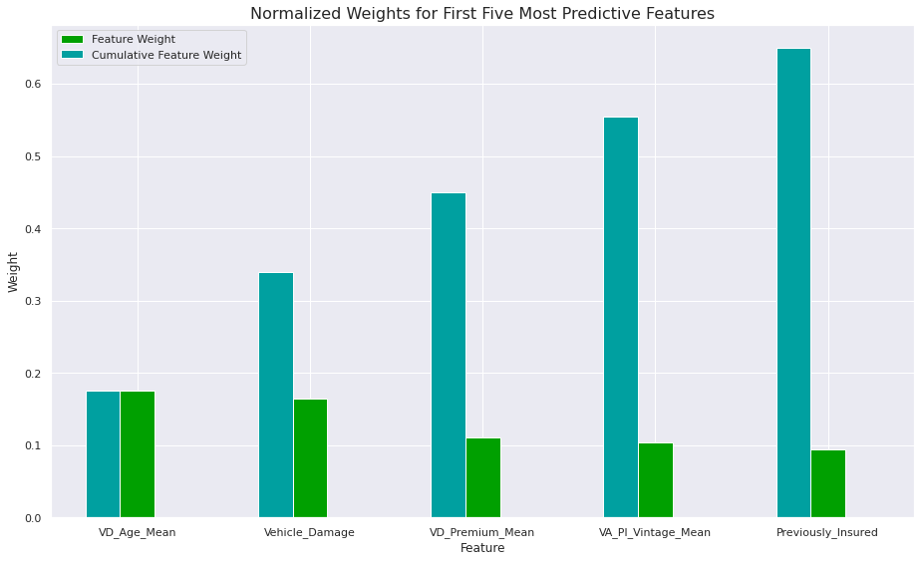
Random Forest Feature Importance

Slide 31


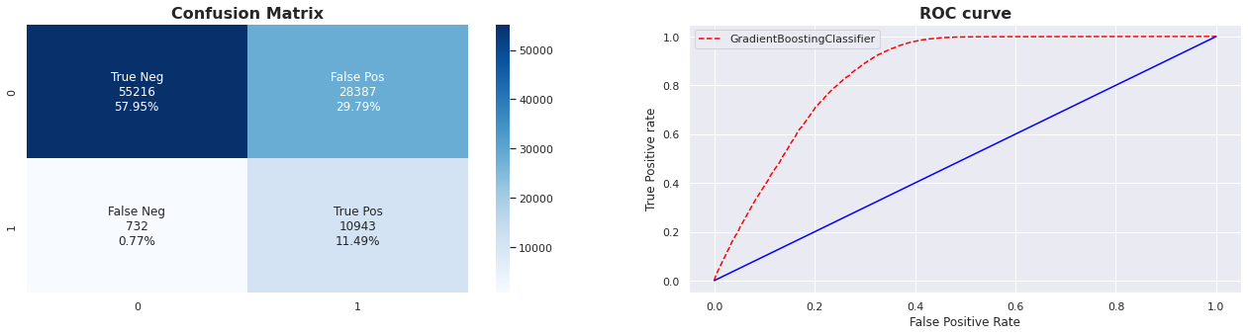
Gradient Boosting Model with Hyperparameter Tuning

Slide 32
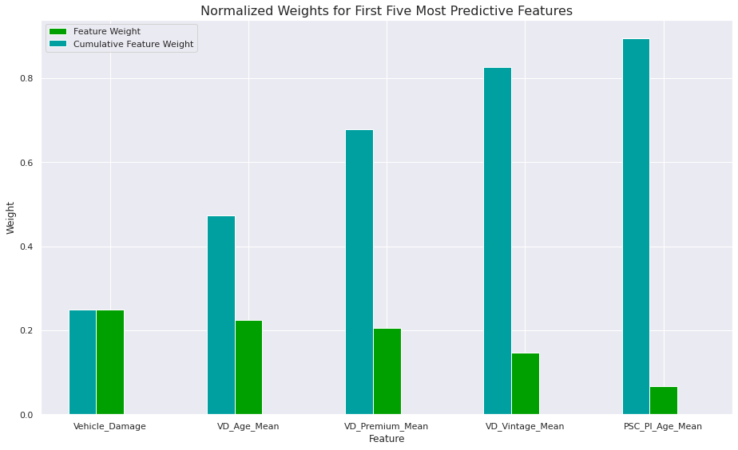
Gradient Boosting Feature Importance

Slide 33


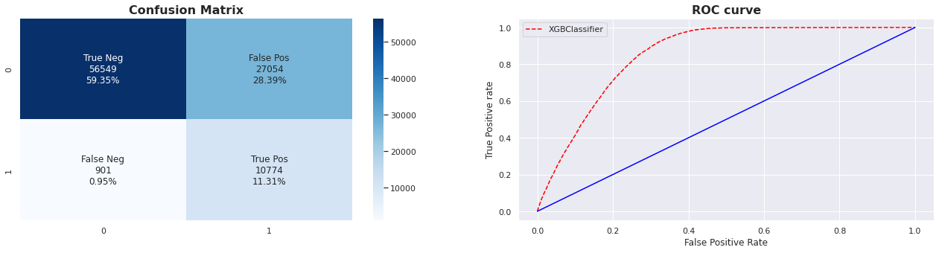
XGBoost Model with Hyperparameter Tuning

Slide 34
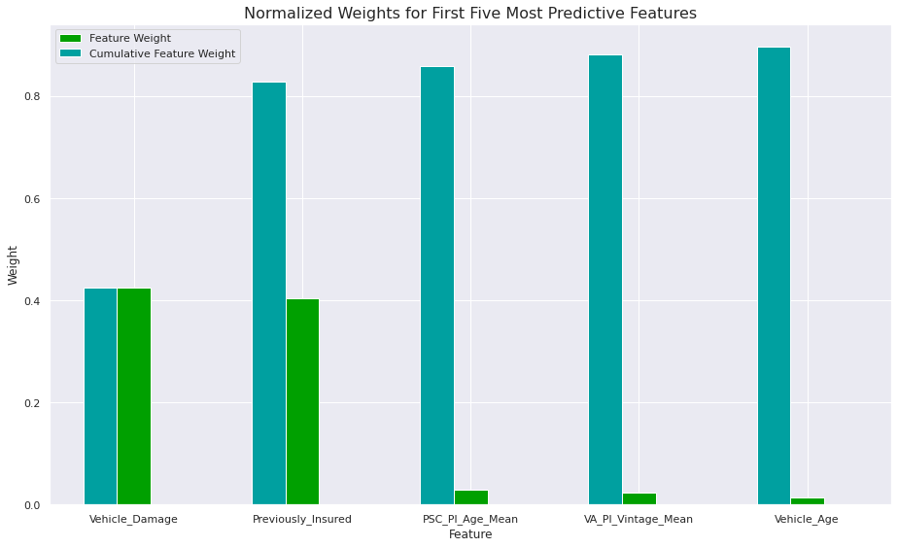
XGBoost Feature Importance

Slide 35
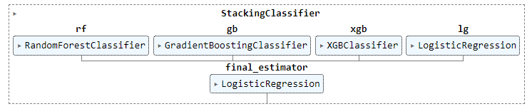
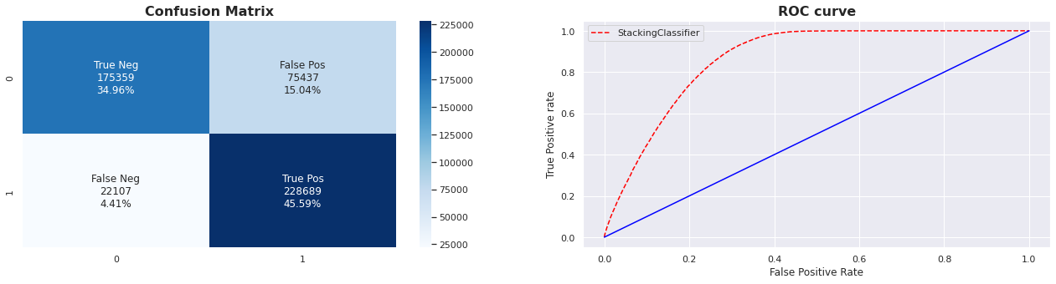

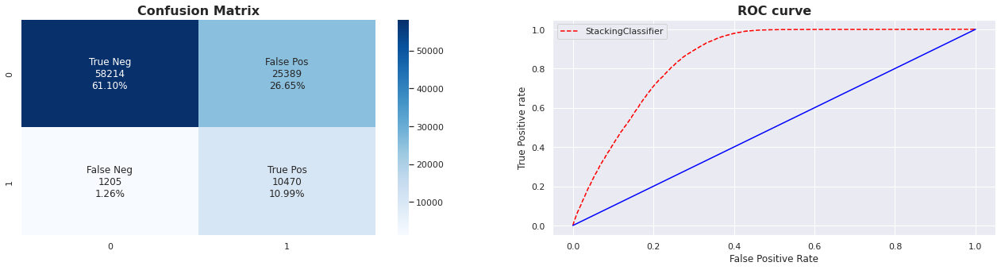
Stacking Classifier Model

Slide 36
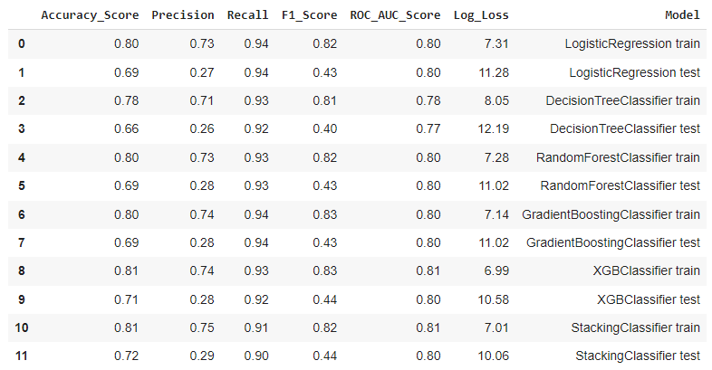
Final Model
We have decided to go ahead with the Gradient Boosting Model as it gives us the tied-best ROC AUC score, highest recall and second-best precision value.
And it also makes the use of a lot of the newly created features of ours and distributes the importance of the features more evenly throughout the dataset.

Slide 37
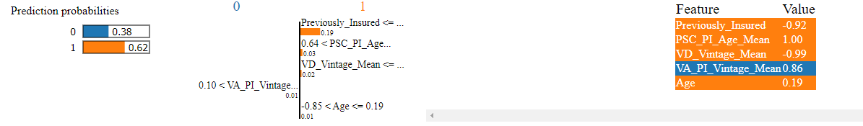
Final Model’s Explainability using LIME
For the given particular datapoint, the probability of the customer buying is high (62%). And four of the five most impacting features push us towards the idea that the customer will buy.
Those four are Previously_Insured, VD_Vintage_Mean (Mean of Vintage for Vehicle_Damage groupby data), PSC_PI_Age_Mean (Mean of Age for the Policy_Sales_Channel and Previously_Insured groupby data) and Age.
Whereas, the feature VA_PI_Vintage_Mean (Mean for Vintage for the Vehicle_Age and Previously_Insured groupby data).

Slide 38
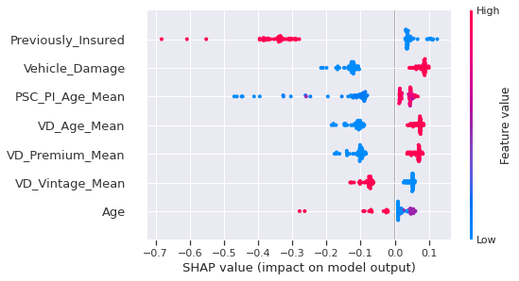
Final Model’s Explainability using SHAP
These are the 7 features that have the most say in our final model. The higher the feature appears, the more its importance.
The violin plots shows how the lower (blue) and higher (red) values for the features are distributed with respect to the SHAP values.
The more it is towards left, the higher chance of model saying the customer won't buy and the more it is on right, the higher chance of model saying the customer will buy.

Slide 39
Conclusion

Slide 40
Conclusion
Getting the sales done is not easy regardless of how much information one can get of the customer. And so, the distribution of sales closed and not closed would be very skewed in nature.
Only 12.26% of the sales were closed by the team.
From the data that we have of our health insurance customers, we understand that 54.18% of them do not have any record of vehicle insurance in the previous years. This certainly is a big market to try and penetrate and so campaigns that helps a user understand the benefits of having a vehicle insurance must be created.
Our health insurance customers' dataset has 54.08% males and 45.92% females. We have not been as popular amongst our female health insurance customers when it comes to swaying them into buying our vehicle insurances as well as we would have liked to. Only 38.93% females have converted and 61.07% males have converted of the ones who converted.
The middle-aged customers showed more interest in our vehicle insurance.

Slide 41
Conclusion
Almost everyone targeted holds a vehicle insurance, as expected. Only 0.21% of the customers targeted don't have a driving license.
Region with code 28 has the most customers and perhaps the highest percentage of success in terms of cross selling. Overall a very small percentage of customers from the regions with most population buy our vehicle insurances.
Customers with vehicles of age between 1 and 2 years have showed the most interest in our insurance. 3/4th of the customers who responded yes belong to this category.
Almost all of the customers who responded yes to buying our vehicle insurance have damaged vehicle. Only 2% don't.
The two types of customers (ones who responded yes and ones who responded no) seem to have similar distribution of their Annual Premium. The distribution is slightly higher for those who responded yes, but the difference is too little to seem significant for the 40-50 percentiles of the customers.
The distribution of the customer's age with the company is same for both the types - ones who bought the vehicle insurance and ones who didn't.

Slide 42

Conclusion
We have decided to go ahead with the hyperparameter-tuned Gradient Boosting Model as it gives us the tied-best ROC AUC score, highest recall and second-best precision value.
And it also makes the use of a lot of the newly created features of ours and distributes the importance of the features more evenly throughout the dataset.

Slide 43
What could have been better?

Slide 44
What could have been better?
We have a very low precision score and that is even though a caveat we have to live with while working with a very highly unbalanced data like ours, we would like to improve it as much as possible given we don't pull down our recall values.
We may have done better with the feature engineering process, even though we believe most of our features have been important in our final model.
And lastly, we believe that a more advanced model like CatBoostClassifier or a Deep Neural Network Classifier could have done a better job.

Slide 45
Thank You

